Slide 1

S³ - Škoda Smart Stream
AI-Powered Learning & Development Platform
Hackathon AI Skill Coach | 42 Prague x 42 Heilbronn

Slide 2
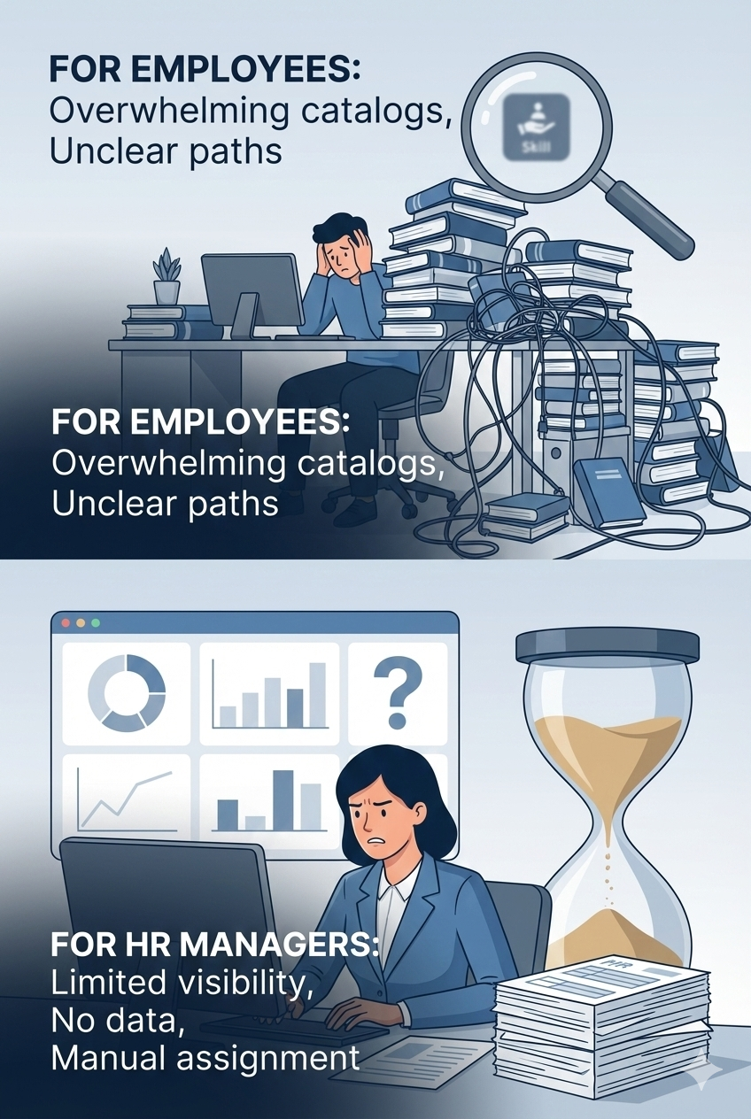
The Challenge
For Employees
For HR Managers
Overwhelming course catalogs (10,000+ courses)
Limited visibility into team skill levels
Unclear skill gaps and development paths
No data-driven approach to L&D planning
No personalized learning recommendations
Difficulty identifying critical skill gaps
Difficulty connecting skills to career goals
Manual, time-consuming course assignment

Slide 3








Our Solution
S³ connects employee skill data with job requirements and career goals using AI-powered analytics
Personalized Development Plans
Skill Gap Analysis
AI-powered recommendations based on skill gaps, role, and career goals
Visual "Swiss Cheese" profiles showing strengths and areas for improvement
Manager Dashboard
Intelligent Course Discovery
Comprehensive analytics for team development planning and training optimization
Semantic search across 10,000+ courses with AI-powered matching

Slide 4

Key Features
For Employees
For HR Managers
Personalized Learning Feed
Employee Search with Filters
Skill Gap Visualization
Analytics Dashboard
Course Recommendations
Department Overview
Progress Tracking
Module Assignment
Advanced Search & Filters
Learning Analytics

Slide 5
Comprehensive Data Integration
We use ALL provided data sources from the Škoda ecosystem
Employee Data
Training History
Degreed Platform
Skill Mapping
Employee profiles, roles, education background
Course completions from Legacy LMS and extended records
External learning platform data and course catalog
Course-to-skill mappings and competency data
Role Requirements
Organization Data
Role-specific responsibilities and requirements
Department structure and organizational relationships

Slide 6
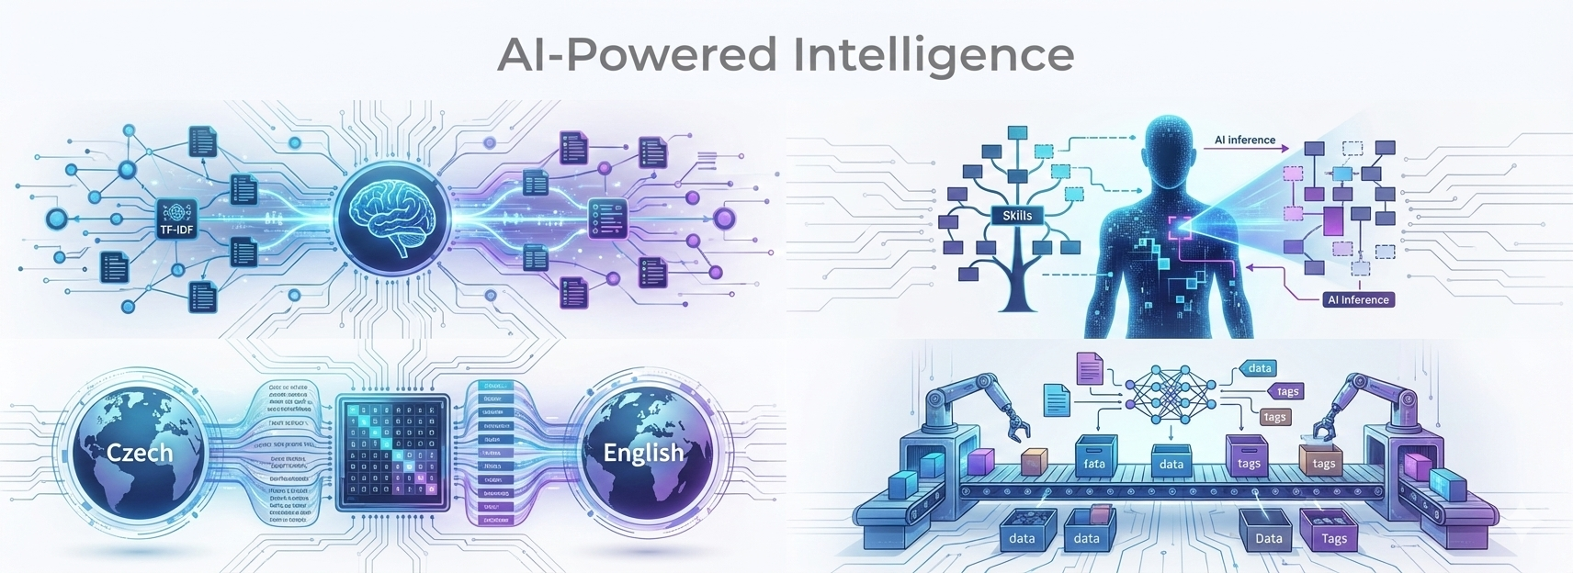





AI-Powered Intelligence
Advanced AI and data analytics at the core of our solution
Semantic Matching
Skill Gap Detection
TF-IDF embeddings for intelligent course matching and recommendations
AI-powered inference of skill levels from learning history
Multi-Language Processing
Intelligent Categorization
Automatic Czech-to-English translation for data unification
Automatic course categorization using keyword analysis

Slide 7
By The Numbers
10,000+
215
296
100%
Courses Available
Employees
Job Descriptions
Data Sources Used
8
3
Data Sources Integrated
Languages Supported

Slide 8




System Architecture
Data Sources
Processing Pipeline
Excel/TXT Files, JSON Data
Loader, Translator, Chunker, Tagger, Embedder
Data Storage
Web Application
Vector Store
Next.js Frontend, React Components, Analytics
Modular, scalable architecture ready for production deployment
Technology Stack
Frontend
Backend & Data Processing
Next.js 15, TypeScript, Tailwind CSS, Recharts, React
Python 3.11+, Pandas, Transformers, scikit-learn, TF-IDF

Slide 9

Impact & Value Proposition
For Employees
For Organization
Reduced time to find relevant courses
Data-driven L&D decisions
Optimized training investments
Clear understanding of skill gaps
Skill-based workforce planning
Personalized learning paths
Career development support
Continuous learning culture
Supporting Škoda's vision: "A culture where lifelong learning is supported and valued"

Slide 10
Thank You
Questions?
S³ — Škoda Smart Stream
AI-Powered Learning & Development Platform

